Slide 1
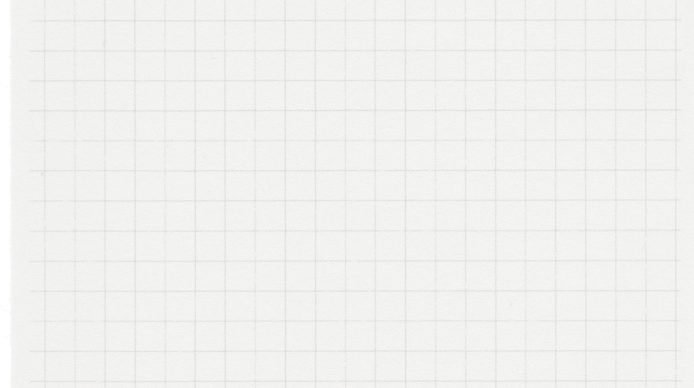

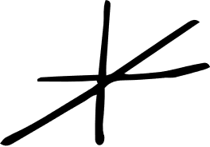
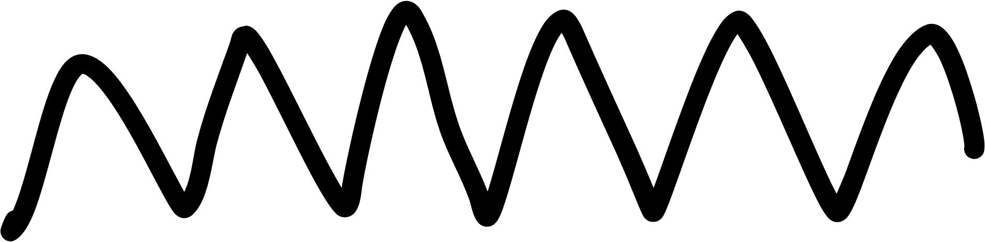









Forest Cover Type Prediction
APPLIED MACHINE LEARNING
Prof. Murat Simsek

Slide 2

Group 4 Names & IDs
Aya Metwally => id: 300389381
Heba Mostafa => id: 300389895
Amira Abu Issa => id: 300389376

Slide 3
Problem’s overview
It is a supervised machine learning classification problem. The objective is to predict the forest cover type (represented as integers) for each 30m x 30m patch in the forest, based on various geographical and environmental features.
A machine learning model is trained on the training set to understand the relationships between the features and the corresponding Cover_Type labels. Once trained, the model is utilized to make predictions for each observation in the test set. To assess the model's performance, appropriate evaluation metrics are employed to measure its accuracy in predicting the forest cover types.

Slide 4
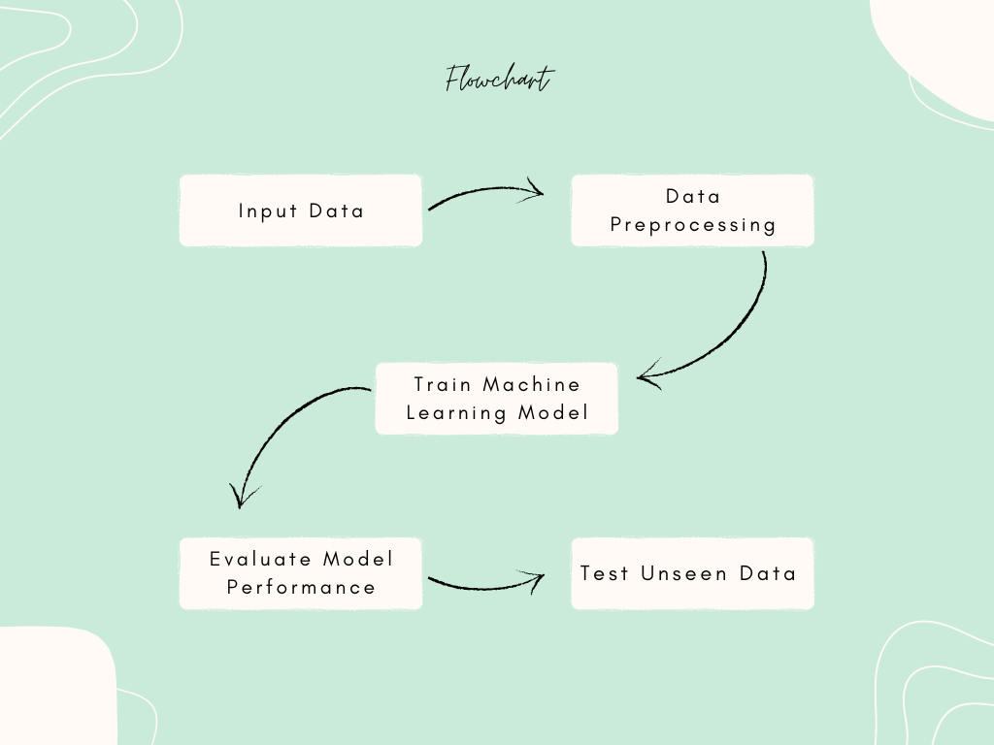

Slide 5
Dataset’s overview
Dataset’s overview
Display the first 5 rows of each dataset (training, validation, test set)
Display more details about each dataset
Do Descriptive statistics
Visualize Histograms for understanding Data Distribution
Visualize Boxplots for summarizing key statistics, and detecting outliers
Visualize Heatmap to identify patterns, trends, and relationships within datasets
Checking data balance

Slide 6
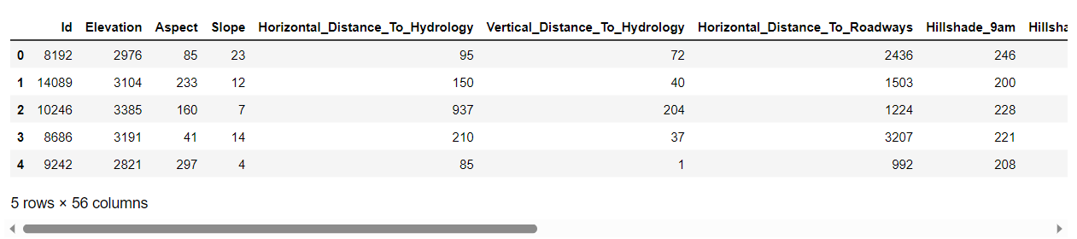
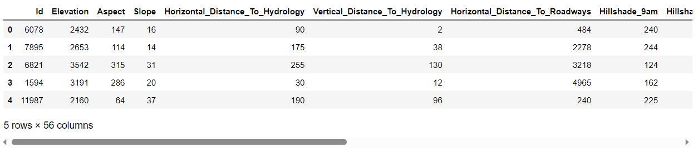
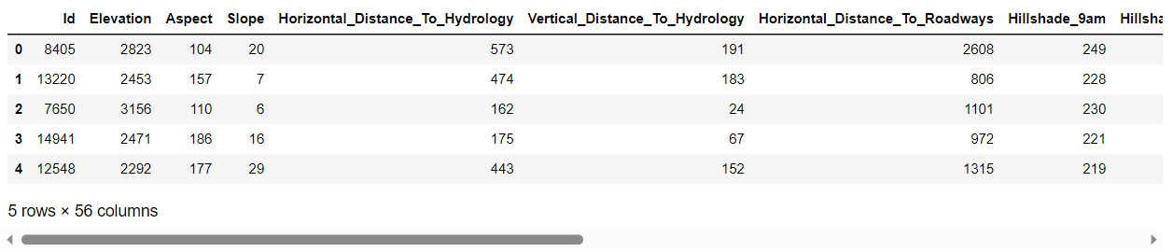
For Training Dataset
For Validation Dataset
For Testing Dataset

Slide 7
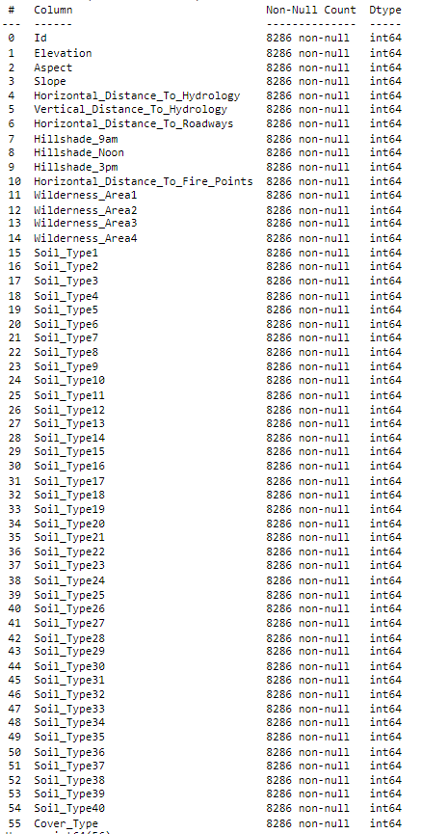
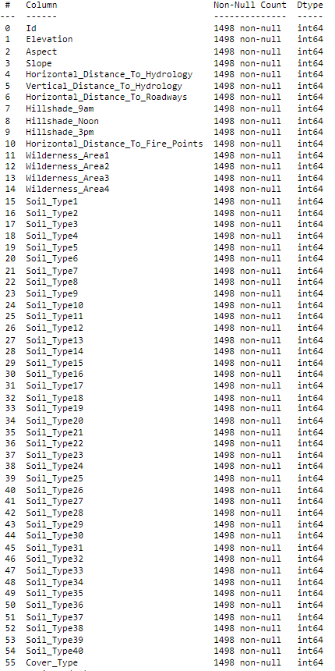
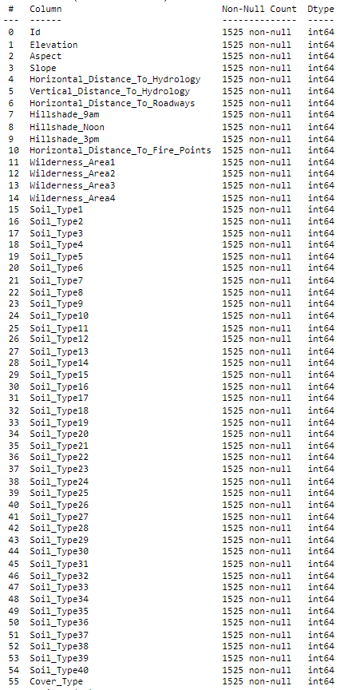
For Training Dataset
For Validation Dataset
For Testing Dataset

Slide 8
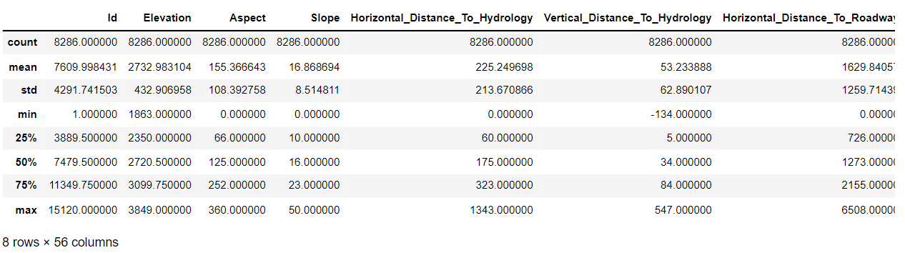
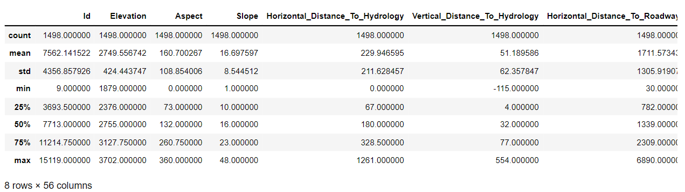
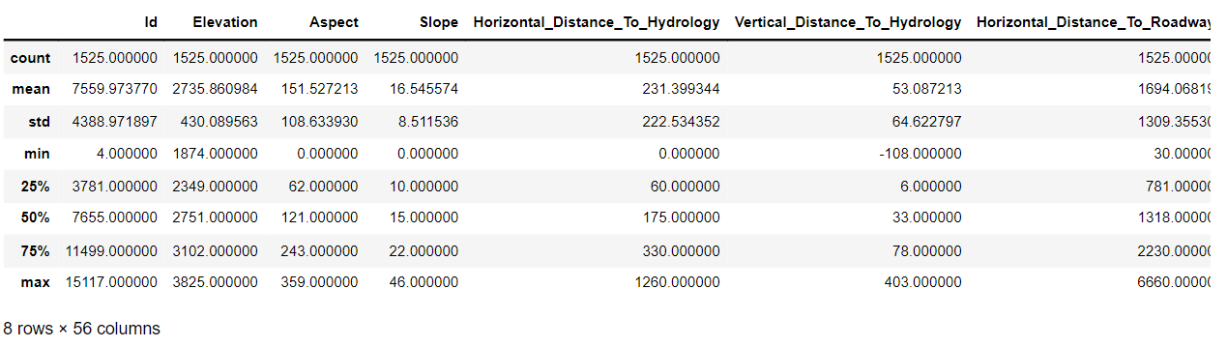
For Training Dataset
For Validation Dataset
For Testing Dataset

Slide 9
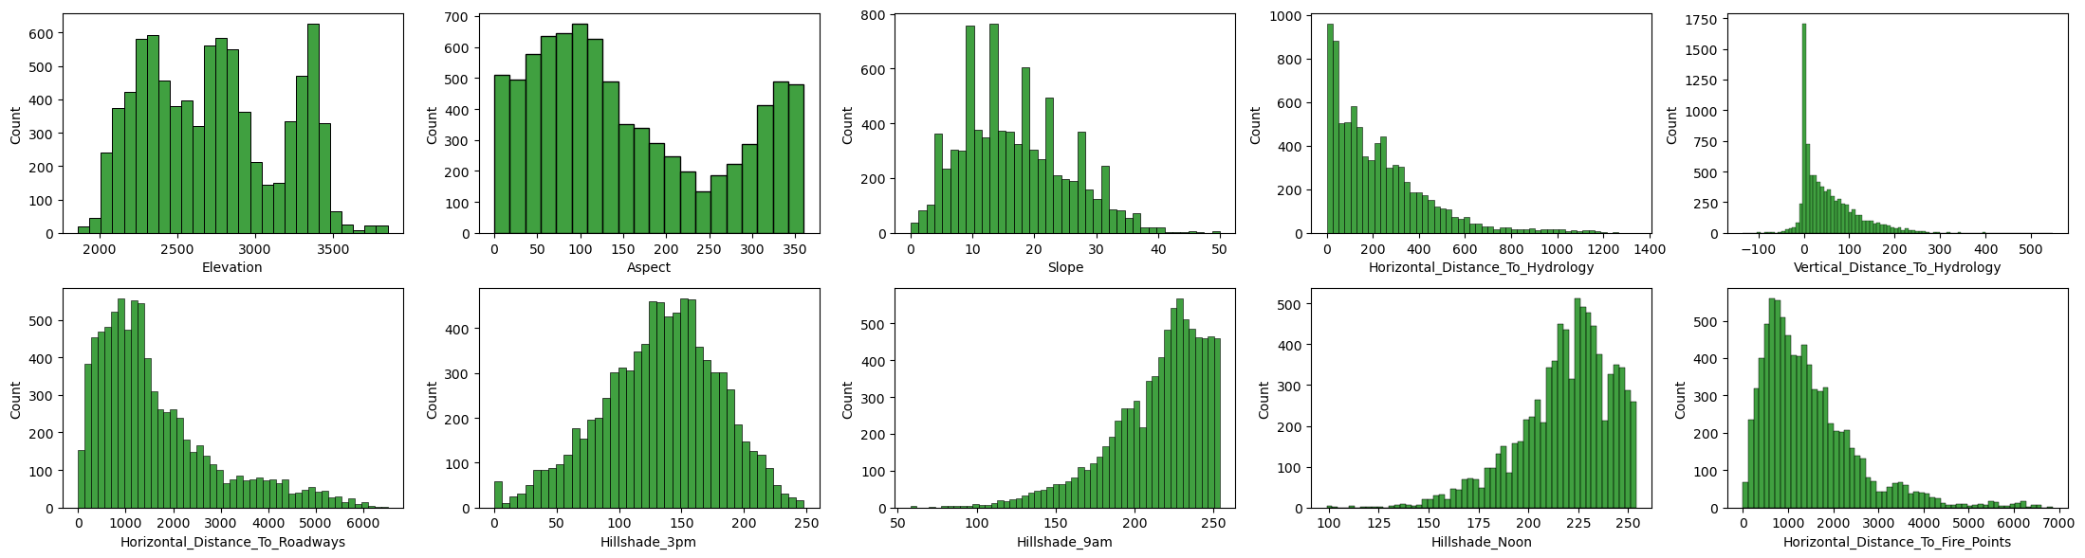
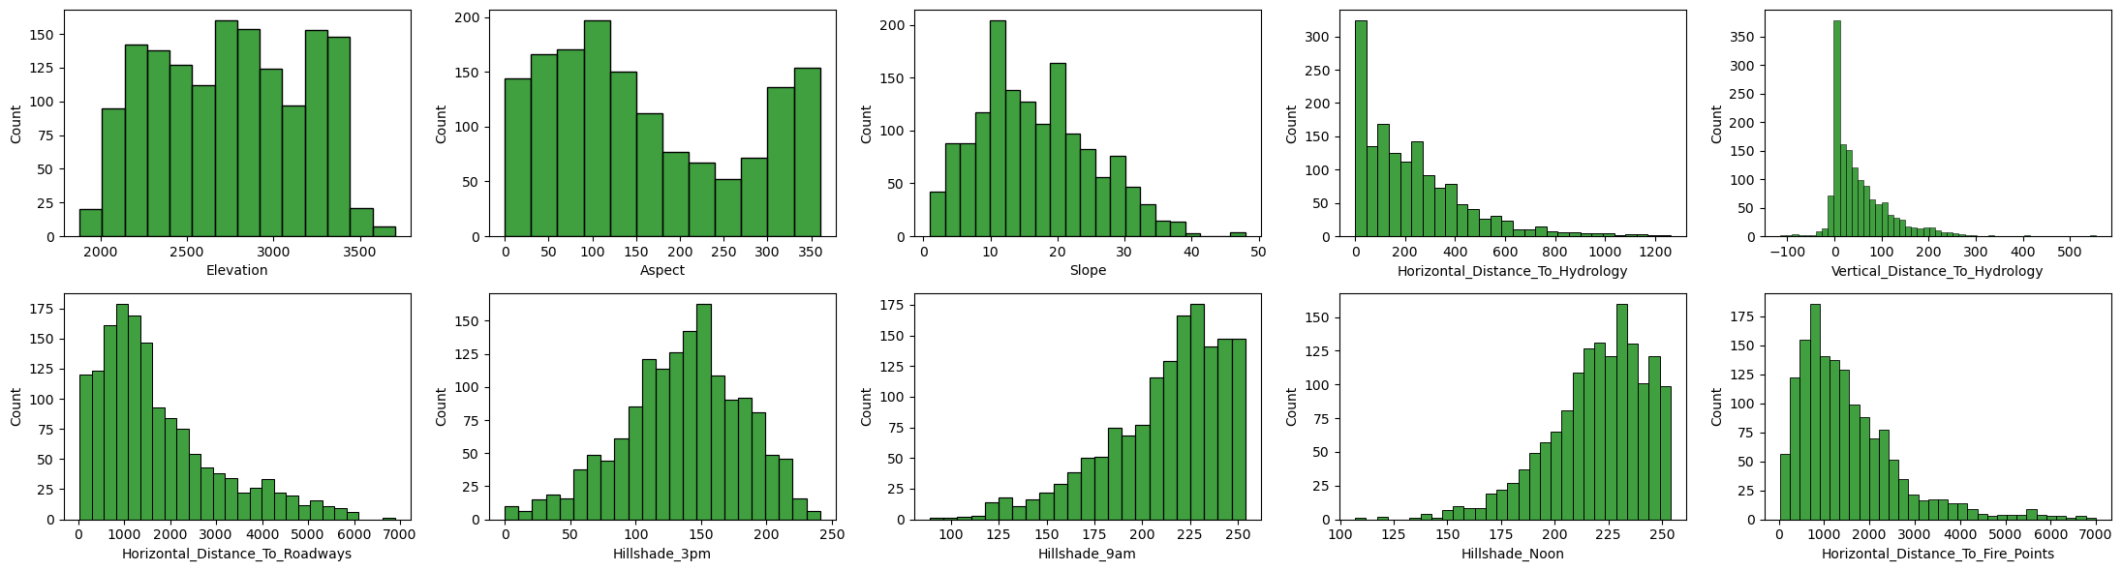
For Training Dataset
For Validation Dataset

Slide 10
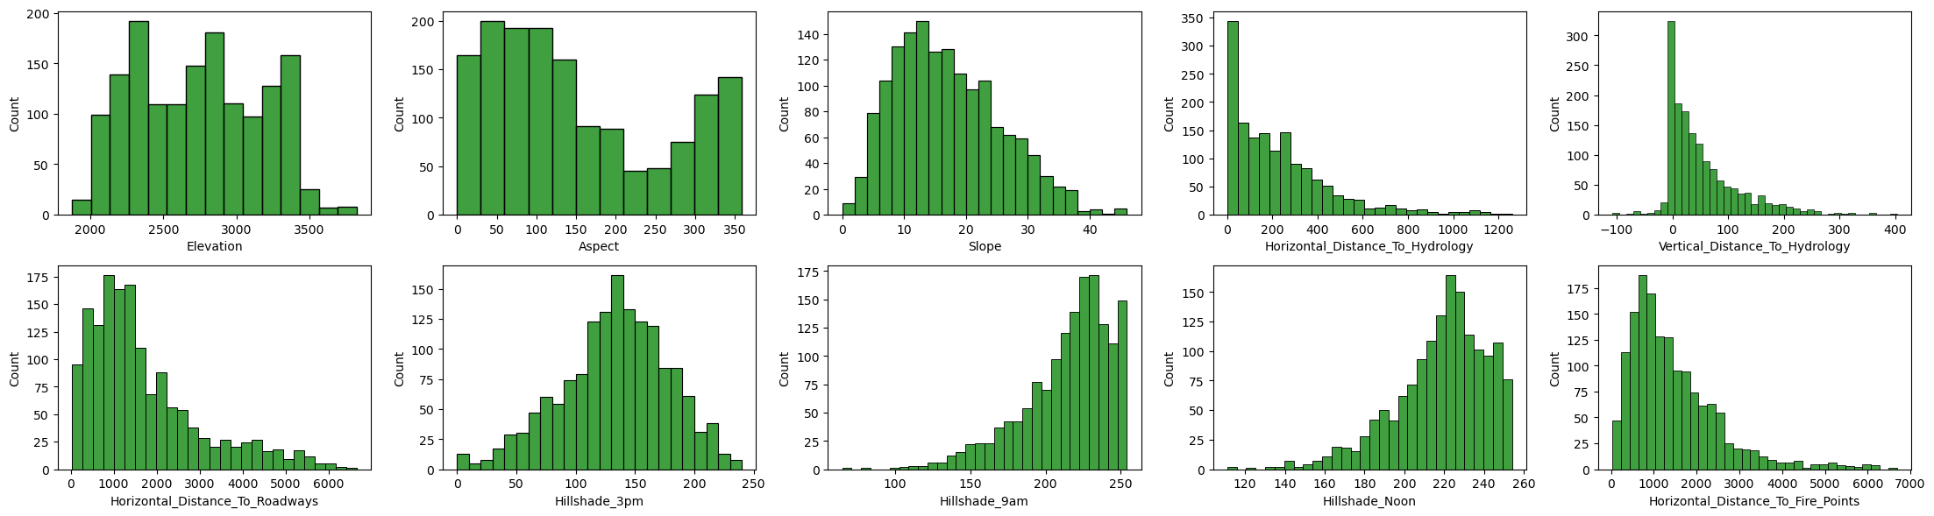
For Testing Dataset

Slide 11
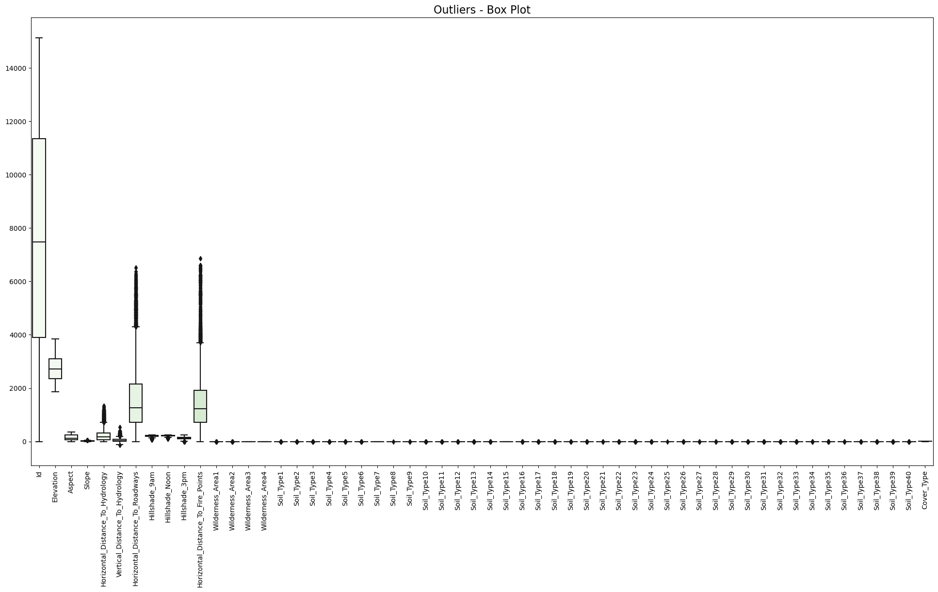
For Training Dataset
\

Slide 12
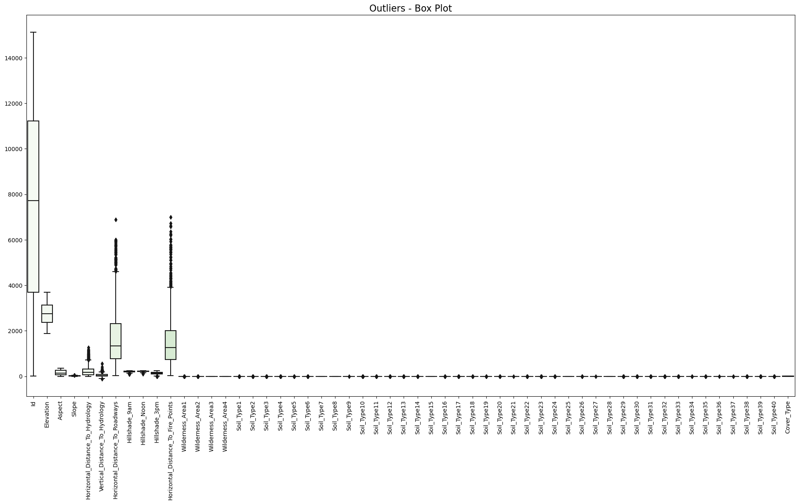
For Validation Dataset
\

Slide 13

For Testing Dataset
\

Slide 14
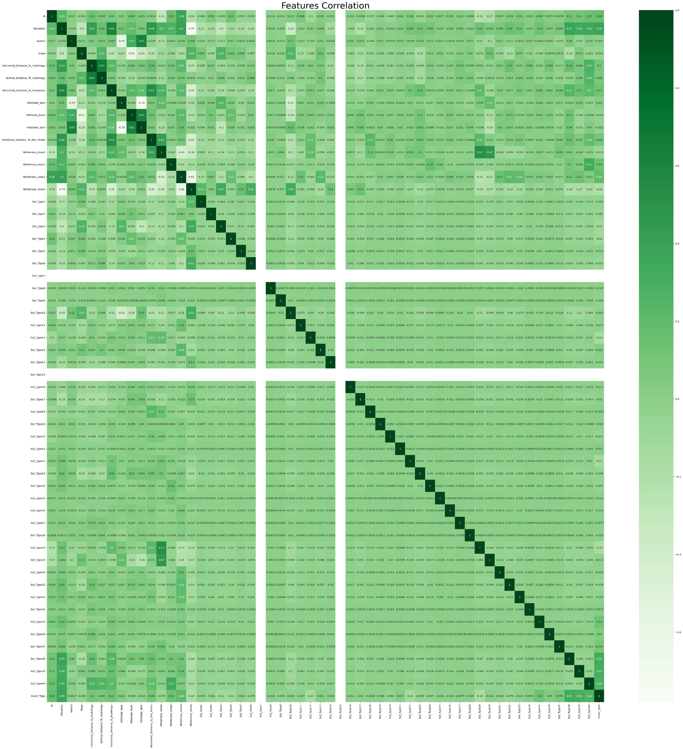
For Training Dataset

Slide 15
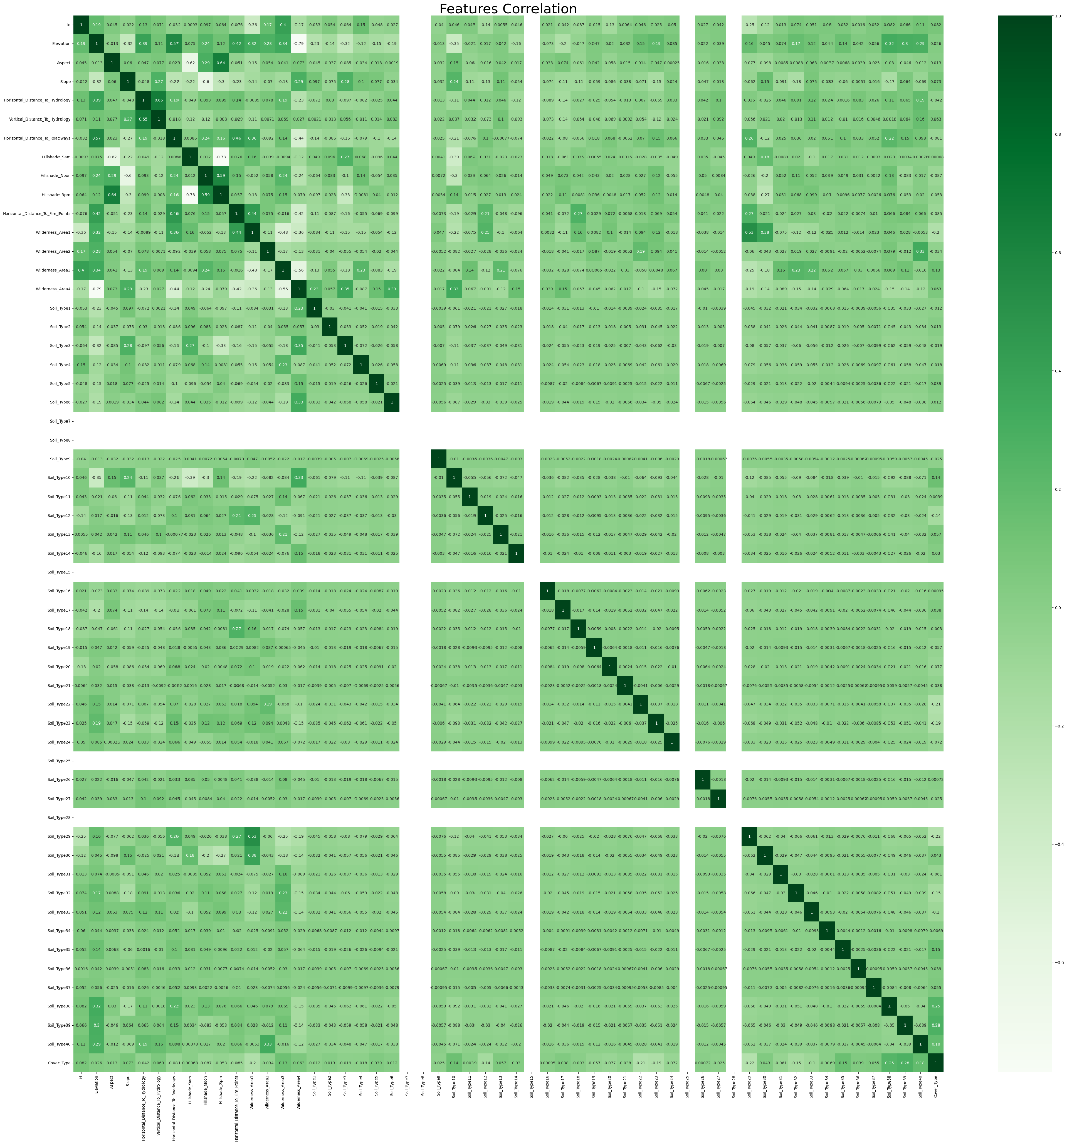
For Validation Dataset

Slide 16
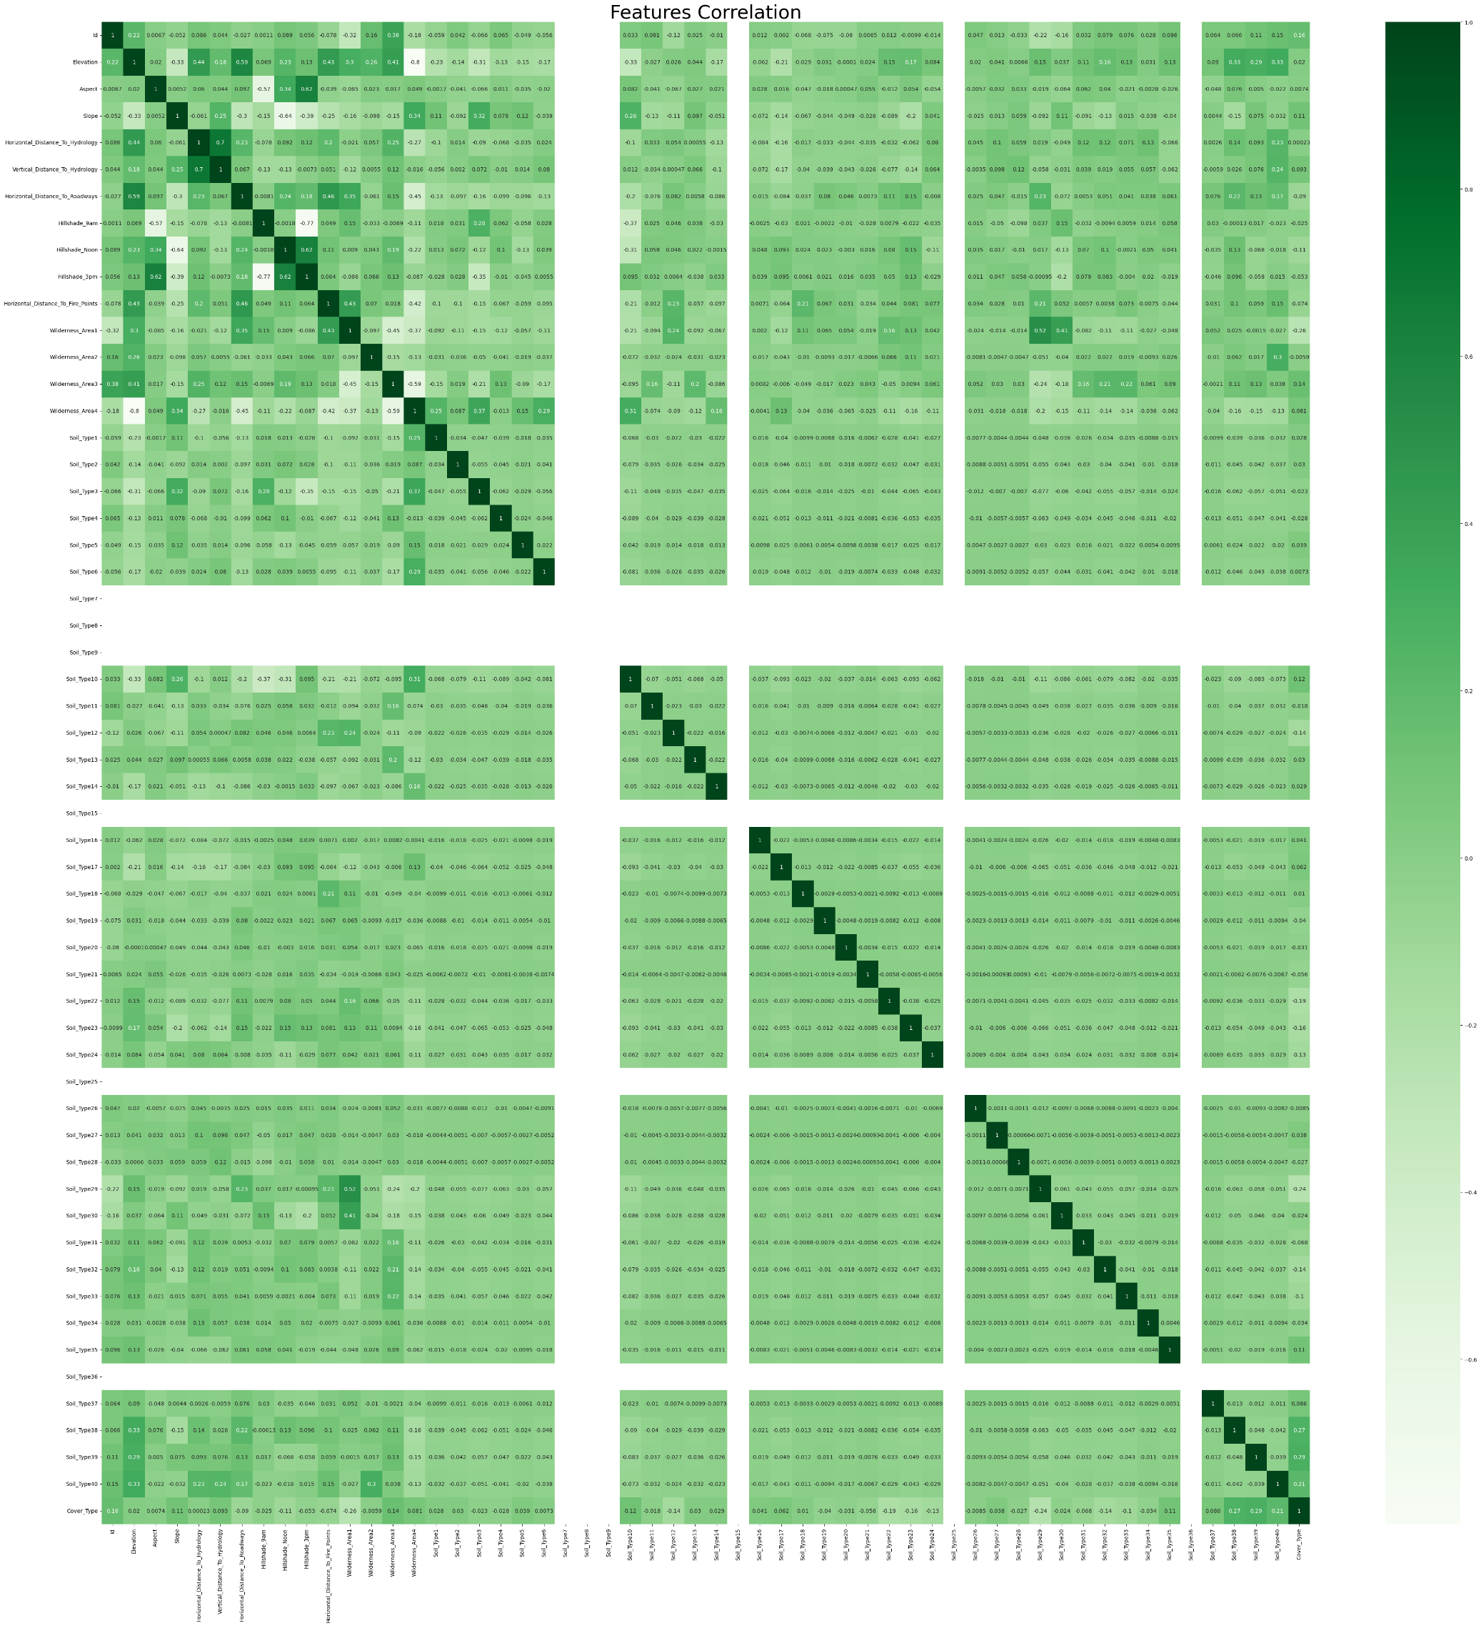
For Testing Dataset

Slide 17
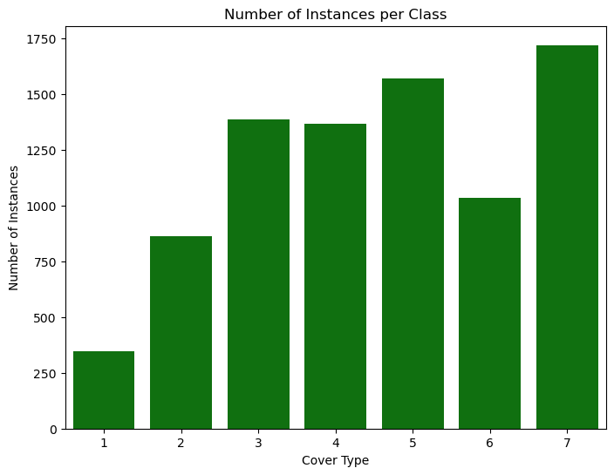
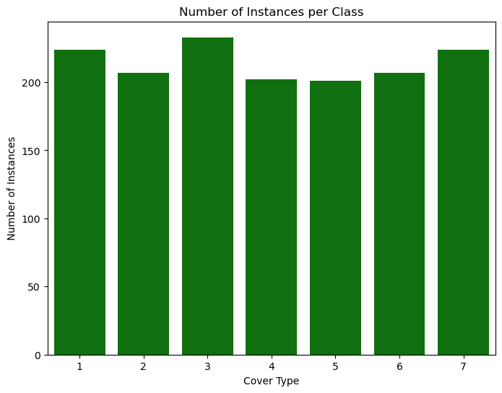
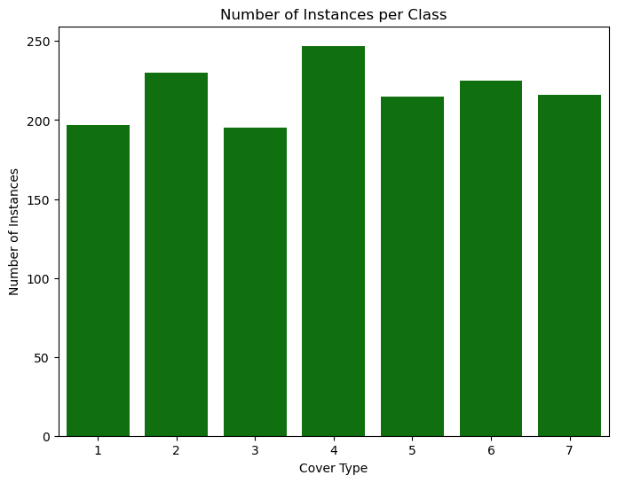
For Training Dataset
For Validation Dataset
For Validation Dataset
On the left figure, we can see that class 1 has fewer samples than others
While on other figures we can obtain that data is balanced

Slide 18
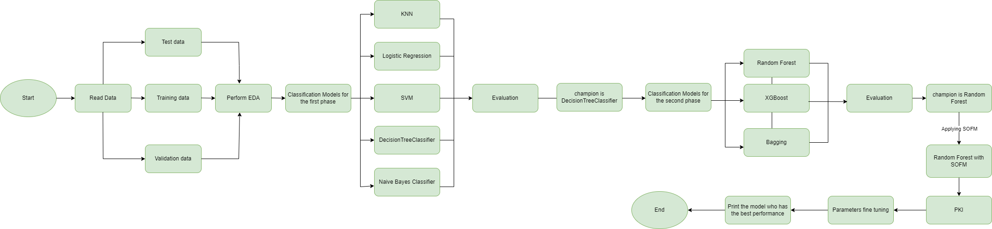
End-to-End Flowchart

Slide 19
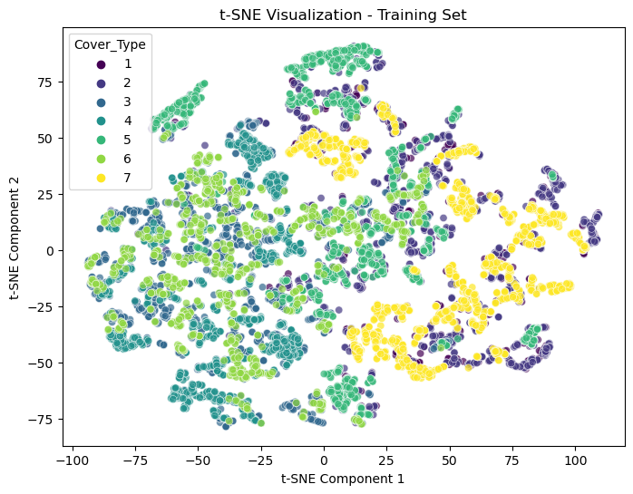
Visualize the training set

Slide 20
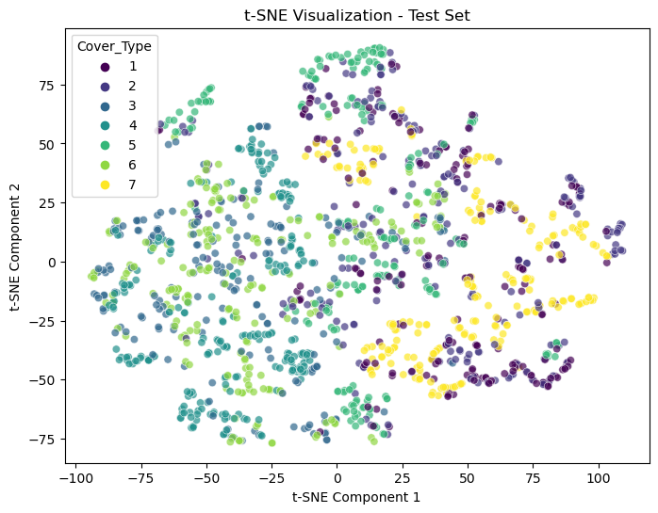
Visualize the test set

Slide 21
Q1) Obtain a baseline performance
Apply these five algorithms, Plot confusion matrix and calculate the accuracy for each model:
KNN
LogisticRegression
SVM
DecisionTreeClassifier
Naive Bayes Classifier

Slide 22
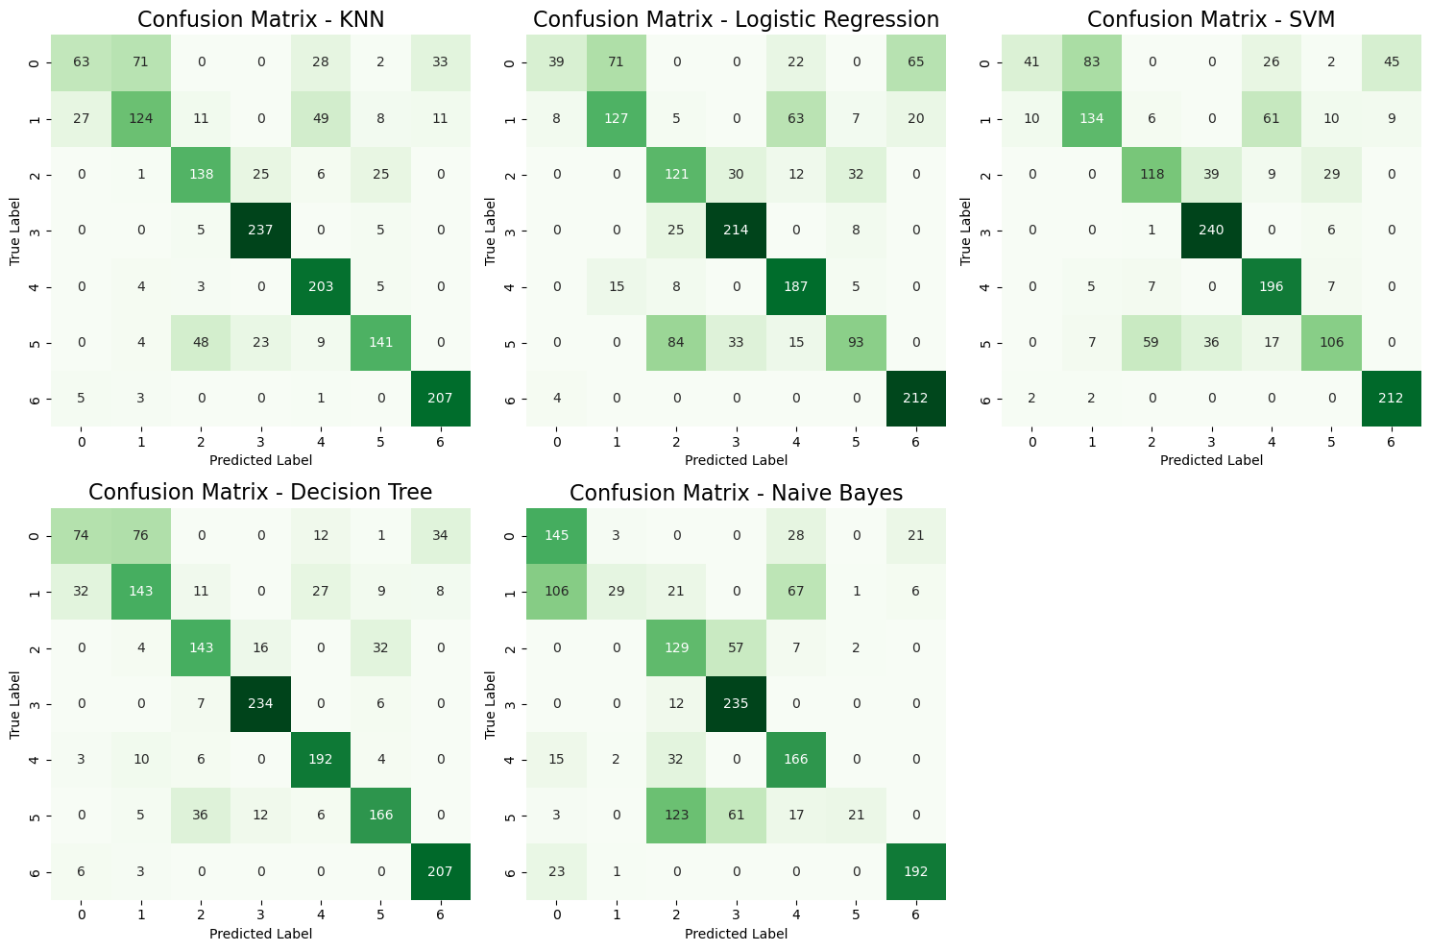
Plot the Confusion Matrix of each model

Slide 23
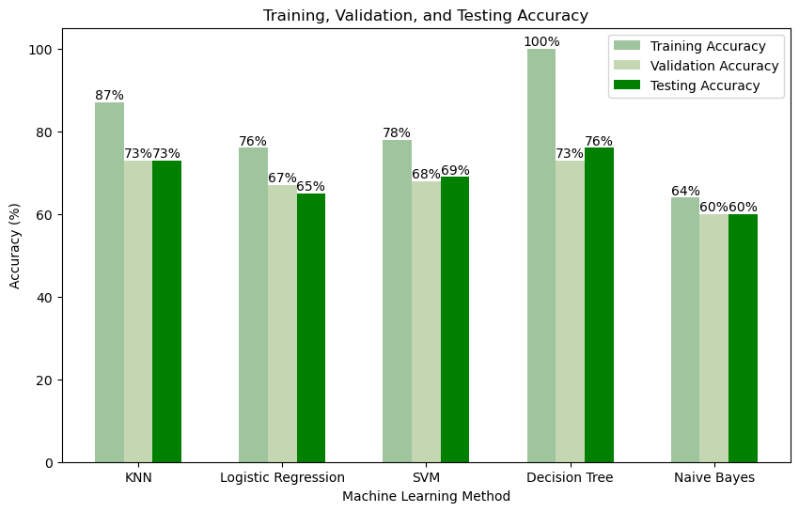
Plot the Accuracy of each Model in a Bar-char
The Base-Line algorithm is Decision Tree with Testing accuracy is 76%

Slide 24
Q2) Comparing Dimensionality Reduction to Feature Selection
Apply feature selection methods:
Filter Based Approach
Wrapper Based Approach

Slide 25
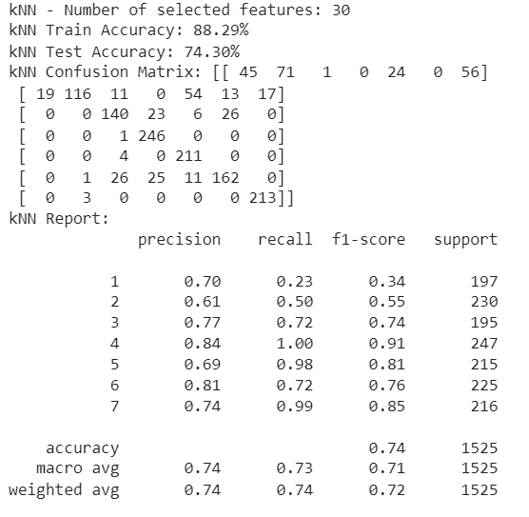
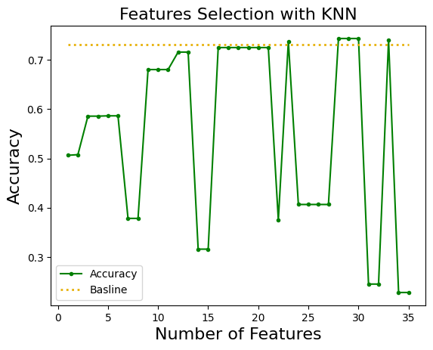
Apply Filter Based Approach using ANOVA

Slide 26
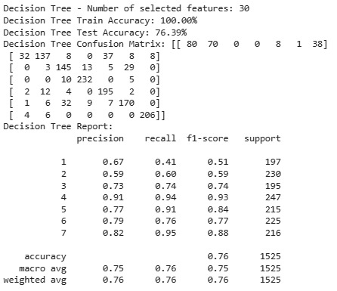
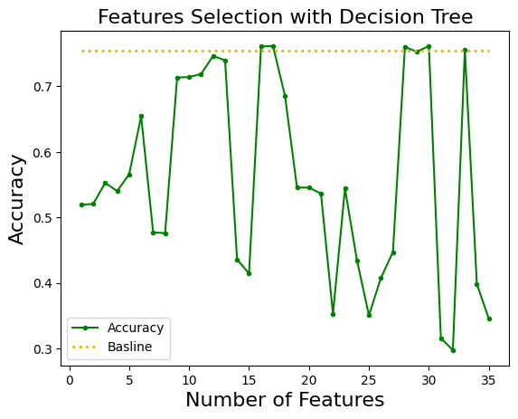
Apply Filter Based Approach using ANOVA

Slide 27
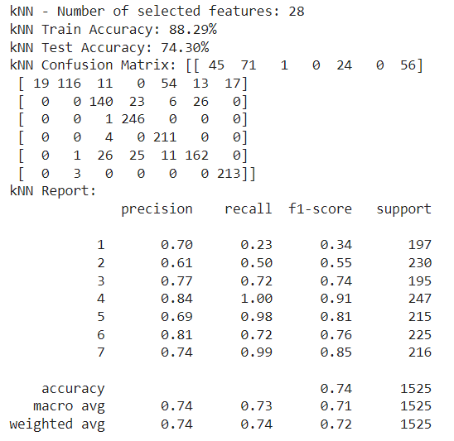
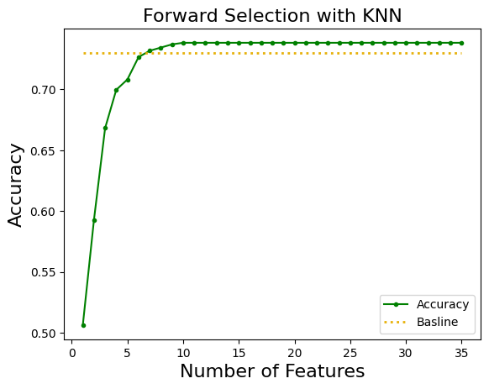
Apply Wrapper Based Approach using Forward Feature Elimination

Slide 28
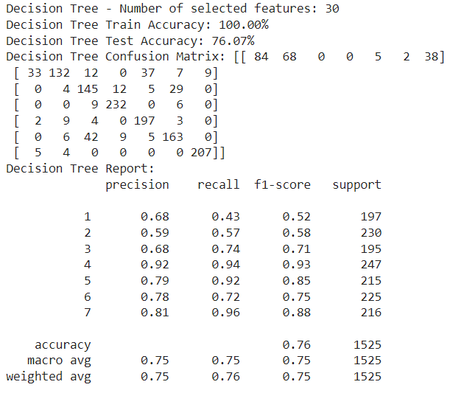
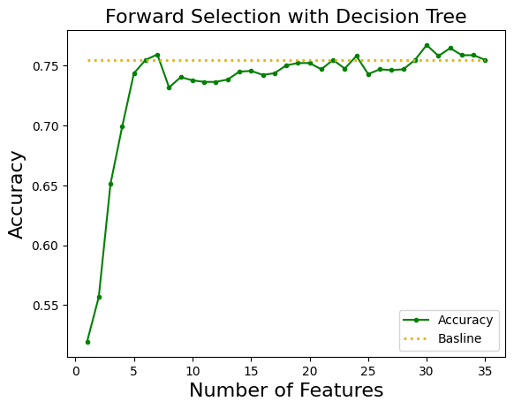
Apply Wrapper Based Approach using Forward Feature Elimination

Slide 29
Comparison for Best Performance
Model / Feature Selection | Decision Tree | KNN
Baseline | 76.1% | 73.0%
ANOVA | 76.39% at k=30 | 74.3% at k=30
Wrapper | 76.07% at k = 30 | 74.30% at k=28

Slide 30
Q3) Adding more machine learning model
Apply Random Forest
Apply XGBoost model
Apply bagging model

Slide 31
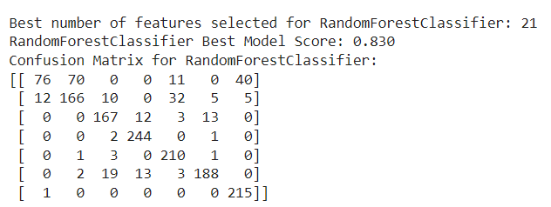
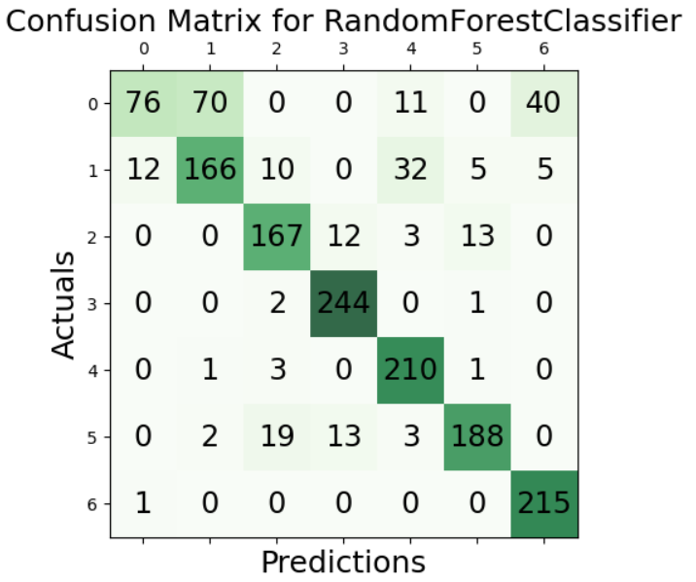
Apply Filter based approach with Random Forest Classifier

Slide 32
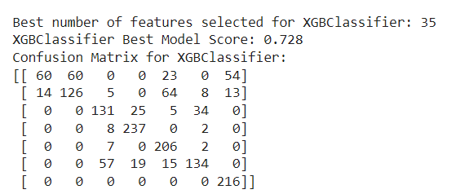
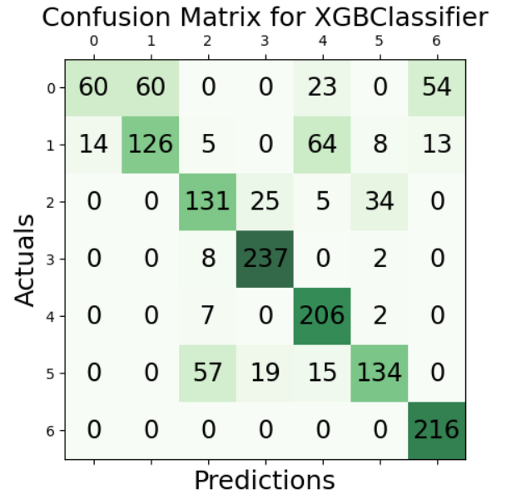
Apply Filter based approach with XGBoost Classifier

Slide 33
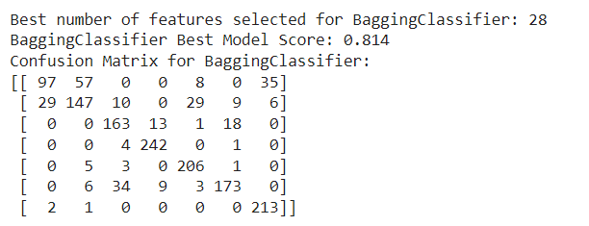
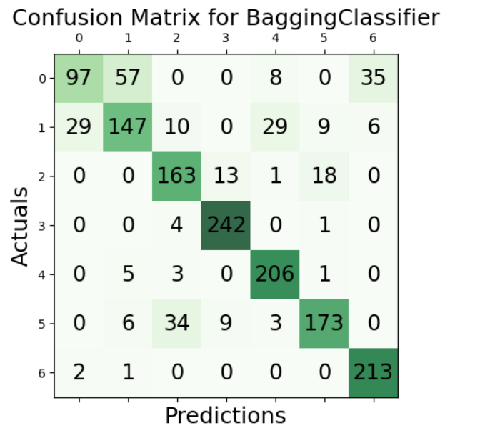
Apply Filter based approach with Bagging Classifier

Slide 34
Comparison for best performance
Model | Random Forest | XGBoost | Bagging Classifier
Accuracy | 81.5% at k = 21 | 72.8% at k = 35 | 81.4% at k = 28
So The Champion Model for this phase is Random Forest which scores 81.5% when the number of features = 21

Slide 35
Q4) Supervised & Unsupervised Combination via PKI
Apply SOFM
Apply DNN
We implement PKI via Deep Neural Network (DNN) which has 4 hidden layers having
30 neurons of each. We use Adam optimizer, set learning rate as 0.001 and choose tanh as the
activation function.

Slide 36
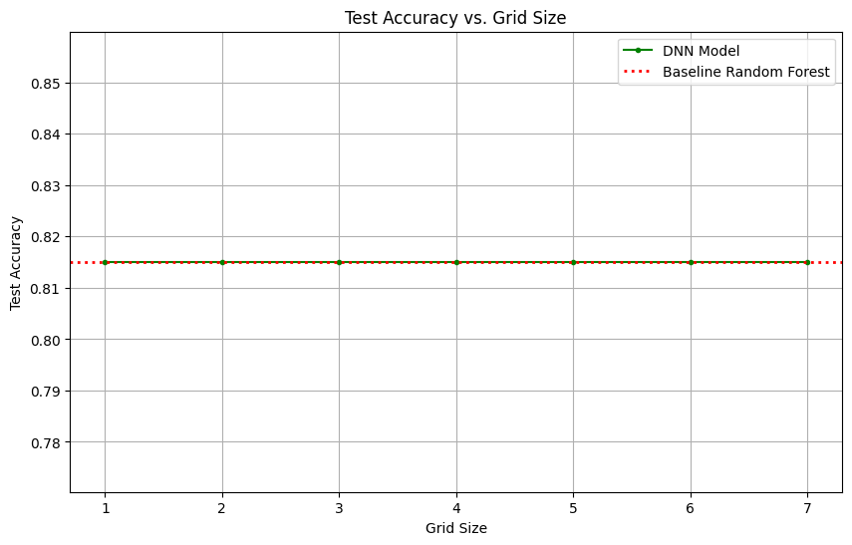
Supervised & Unsupervised Combination via PKI

Slide 37
Q5) Applying parameter fine tuning
We try different structures for Deep Neural Network for PKI structure
We plot each tunning performance of hidden layers and neurons of each hidden layers with given the best accuracy so far as red dotted line

Slide 38
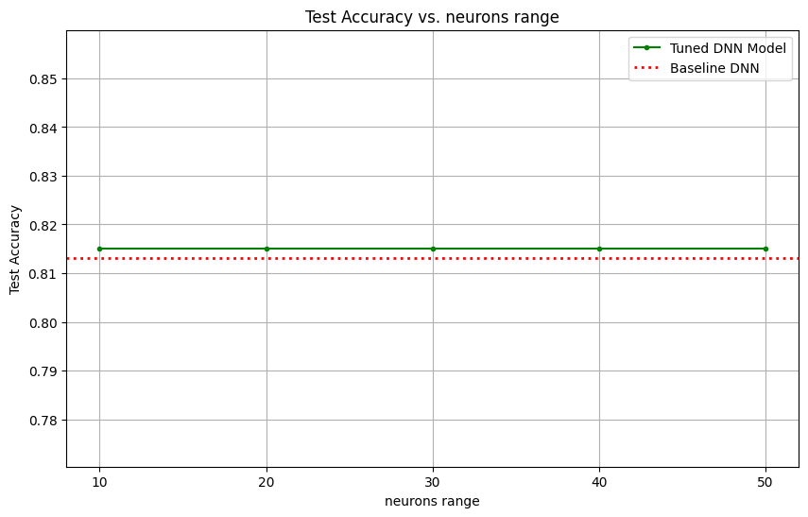
Applying parameter fine tuning to get better performance from the previous best performance

Slide 39

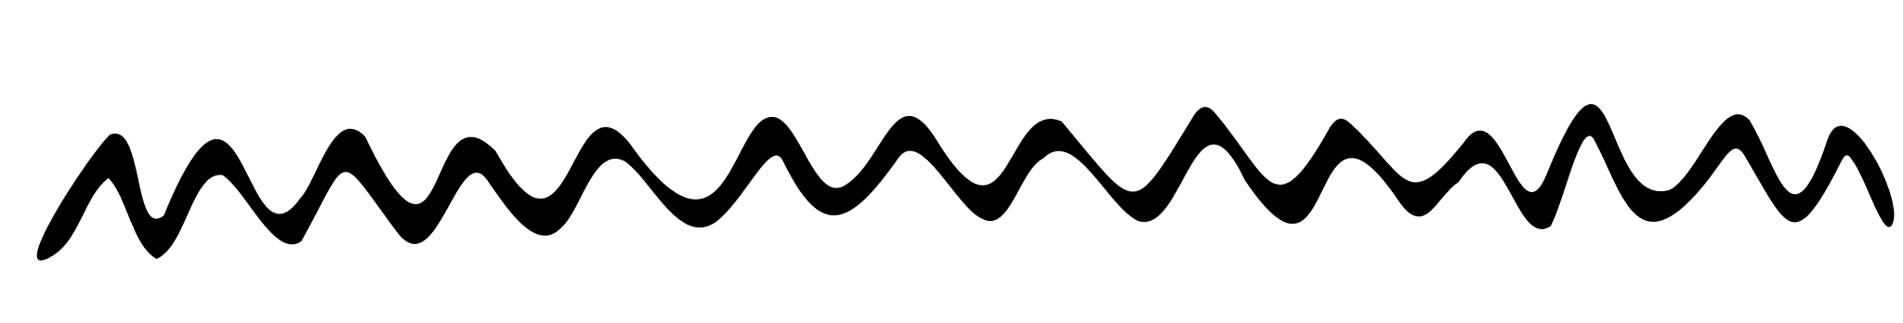
Conclusion
Q1:
Decision Tree is the baseline as it achieves the best performance with highest testing accuracy of 76%
KNN is the second best ML model with 73% of testing accuracy
Q2:
Dimensionality reduction and feature selection process using Sequential Feature Selector (SFS) with Decision Tree (DT) and k-Nearest Neighbors (KNN) classifiers could improve the accuracy slightly to the accuracy of the baseline.
Q3: After the last calculations in Q2 and Q3 we found out that the Champion model is Random Forest Classifier with accuracy score 81.5% when number of features(K) = 21
Q4:we implement PKI and plot the accuracy vs. number of neurons and notice that accracy does not improve than baseline Random Forest accuracy
Q5: we try different structures of deep neural network for PKI structure and improve the accuracy than previous improvement

Slide 40
Thank you!
By Group 4

